Slide 1
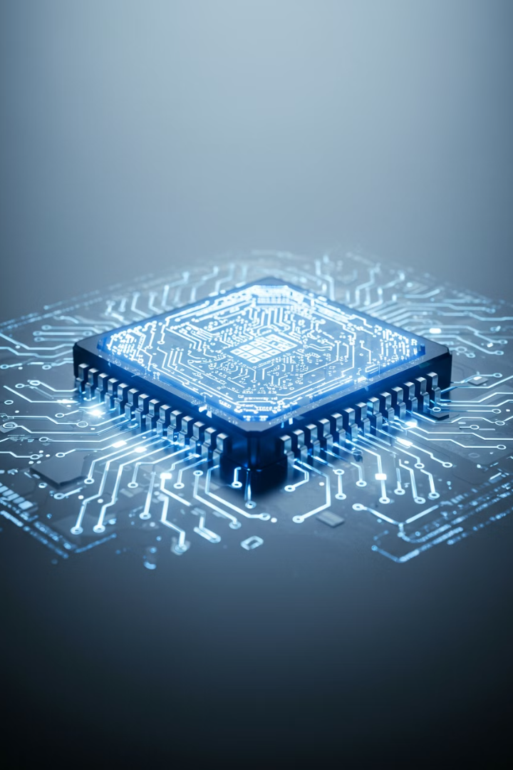

What is a
Central Processing Unit (CPU)?
The Central Processing Unit (CPU) is the brain of the computer. It is one of the most important parts because it does all the thinking and processing for the computer. Without a CPU, the computer cannot perform any tasks.
by Ram N Java

Slide 2

What Does the CPU Do?
1
Processes Instructions
2
Performs Calculations
3
Manages Data
The CPU follows instructions from programs and the operating system (like Windows or macOS).
The CPU does all the math and logical operations needed to run programs.
The CPU moves data between different parts of the computer, like RAM and storage.
Example: If you add numbers in a spreadsheet, the CPU does the calculations.
Example: When you save a file, the CPU sends the data to the storage drive.
Example: When you open a browser or play a game, the CPU processes the instructions to make it work.

Slide 3




How Does the CPU Work?
Fetch
Decode
The CPU fetches instructions from the computer's memory (RAM).
It decodes the instructions to understand
what needs to be done.
Execute
Store
It executes the instructions by performing the
required tasks.
Finally, it stores the results back in memory or sends them to an output device (like the monitor).
This process happens billions of times per second, making the CPU incredibly fast and efficient.

Slide 4

Key Features of a CPU
Cores
Clock Speed
Modern CPUs have multiple cores (like having multiple brains).
Measured in gigahertz (GHz), this tells you how fast the CPU can process instructions.
Example: A dual-core CPU has 2 cores, a quad-core CPU has 4 cores, and so on.
Example: A CPU with a clock speed of 3.5 GHz is faster than one with 2.0 GHz.
More cores allow the CPU to handle
multiple tasks at once.

Slide 5
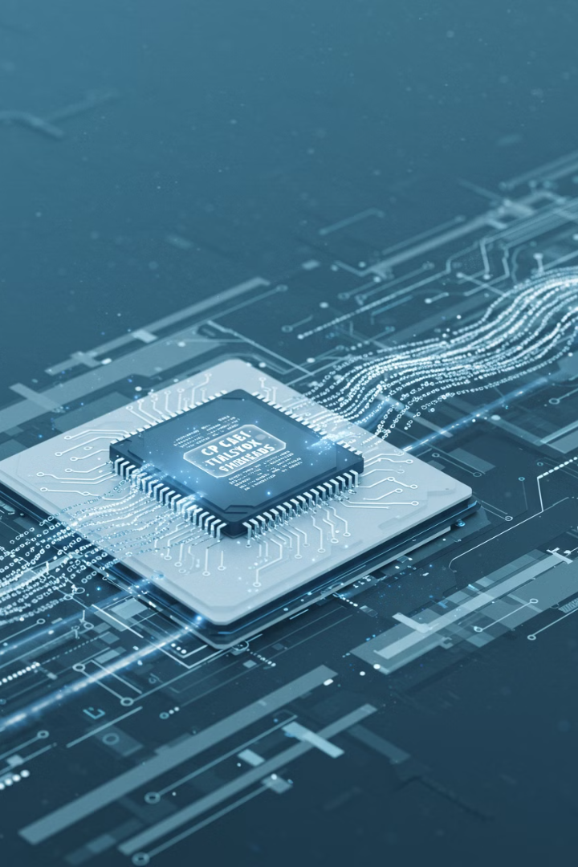
More Key Features of a CPU
Cache
A small amount of super-fast memory inside the CPU.
It stores frequently used data so the CPU can access it quickly.
Threads
Some CPUs support multithreading, which allows each core to handle multiple tasks at once.
Example: A quad-core CPU with multithreading can handle 8 tasks simultaneously.

Slide 6
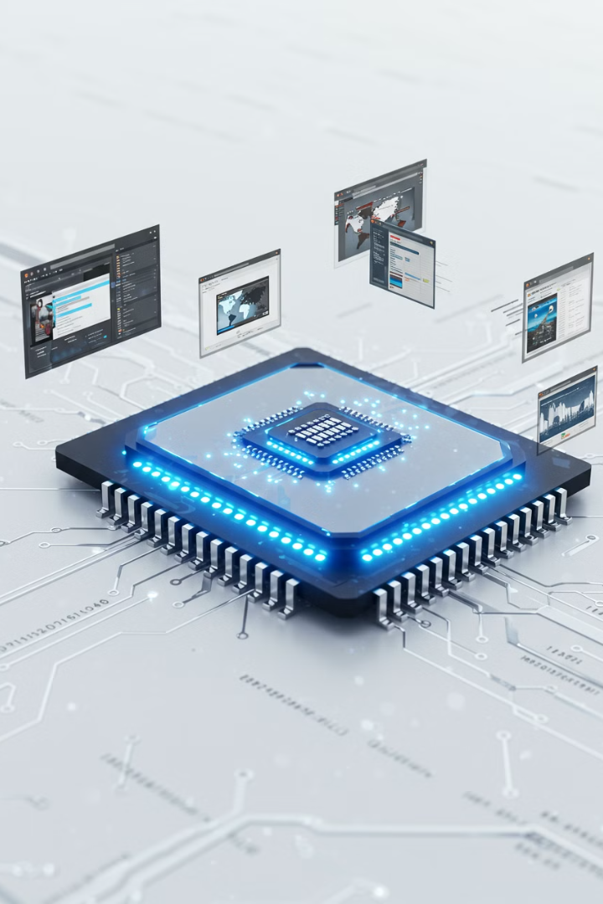



Why is the CPU Important?
Performance
Multitasking
Gaming and Editing
A faster CPU means your computer can run programs more quickly and smoothly.
A CPU with more cores and threads can handle multiple tasks at once, like browsing the web while listening to music.
A powerful CPU is essential for gaming, video editing, and other demanding tasks.

Slide 7
Examples of CPU Brands
Intel
AMD
Popular series: Core i3, Core i5, Core i7, Core i9.
Popular series: Ryzen 3, Ryzen 5, Ryzen 7, Ryzen 9.

Slide 8
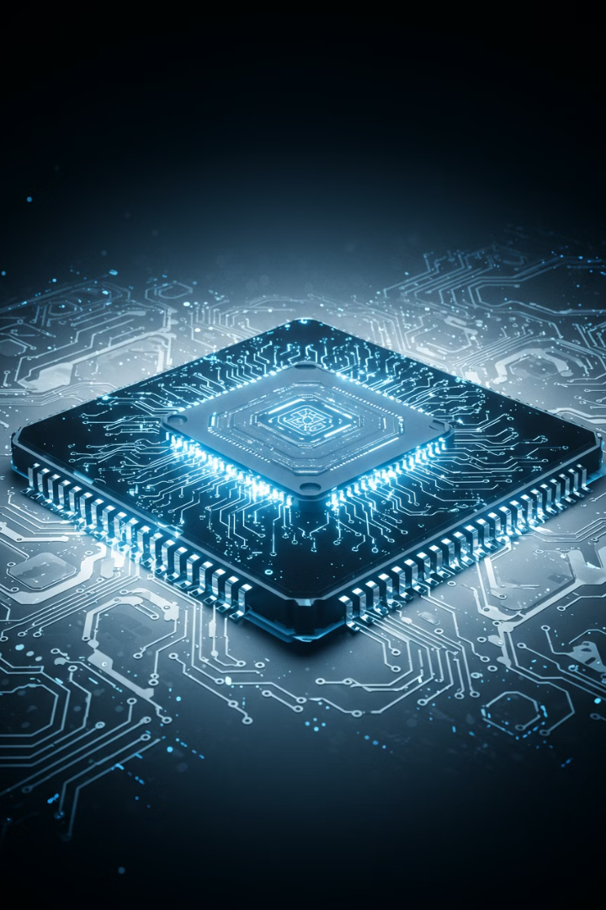
Simple Summary
1
The CPU is the brain of the computer.
2
It processes instructions, performs calculations, and manages data.
3
Key features include cores, clock speed, cache, and threads.
4
A faster and more powerful CPU means better performance and multitasking.
The CPU is the heart of your computer, making sure everything runs smoothly.

